Slide 1
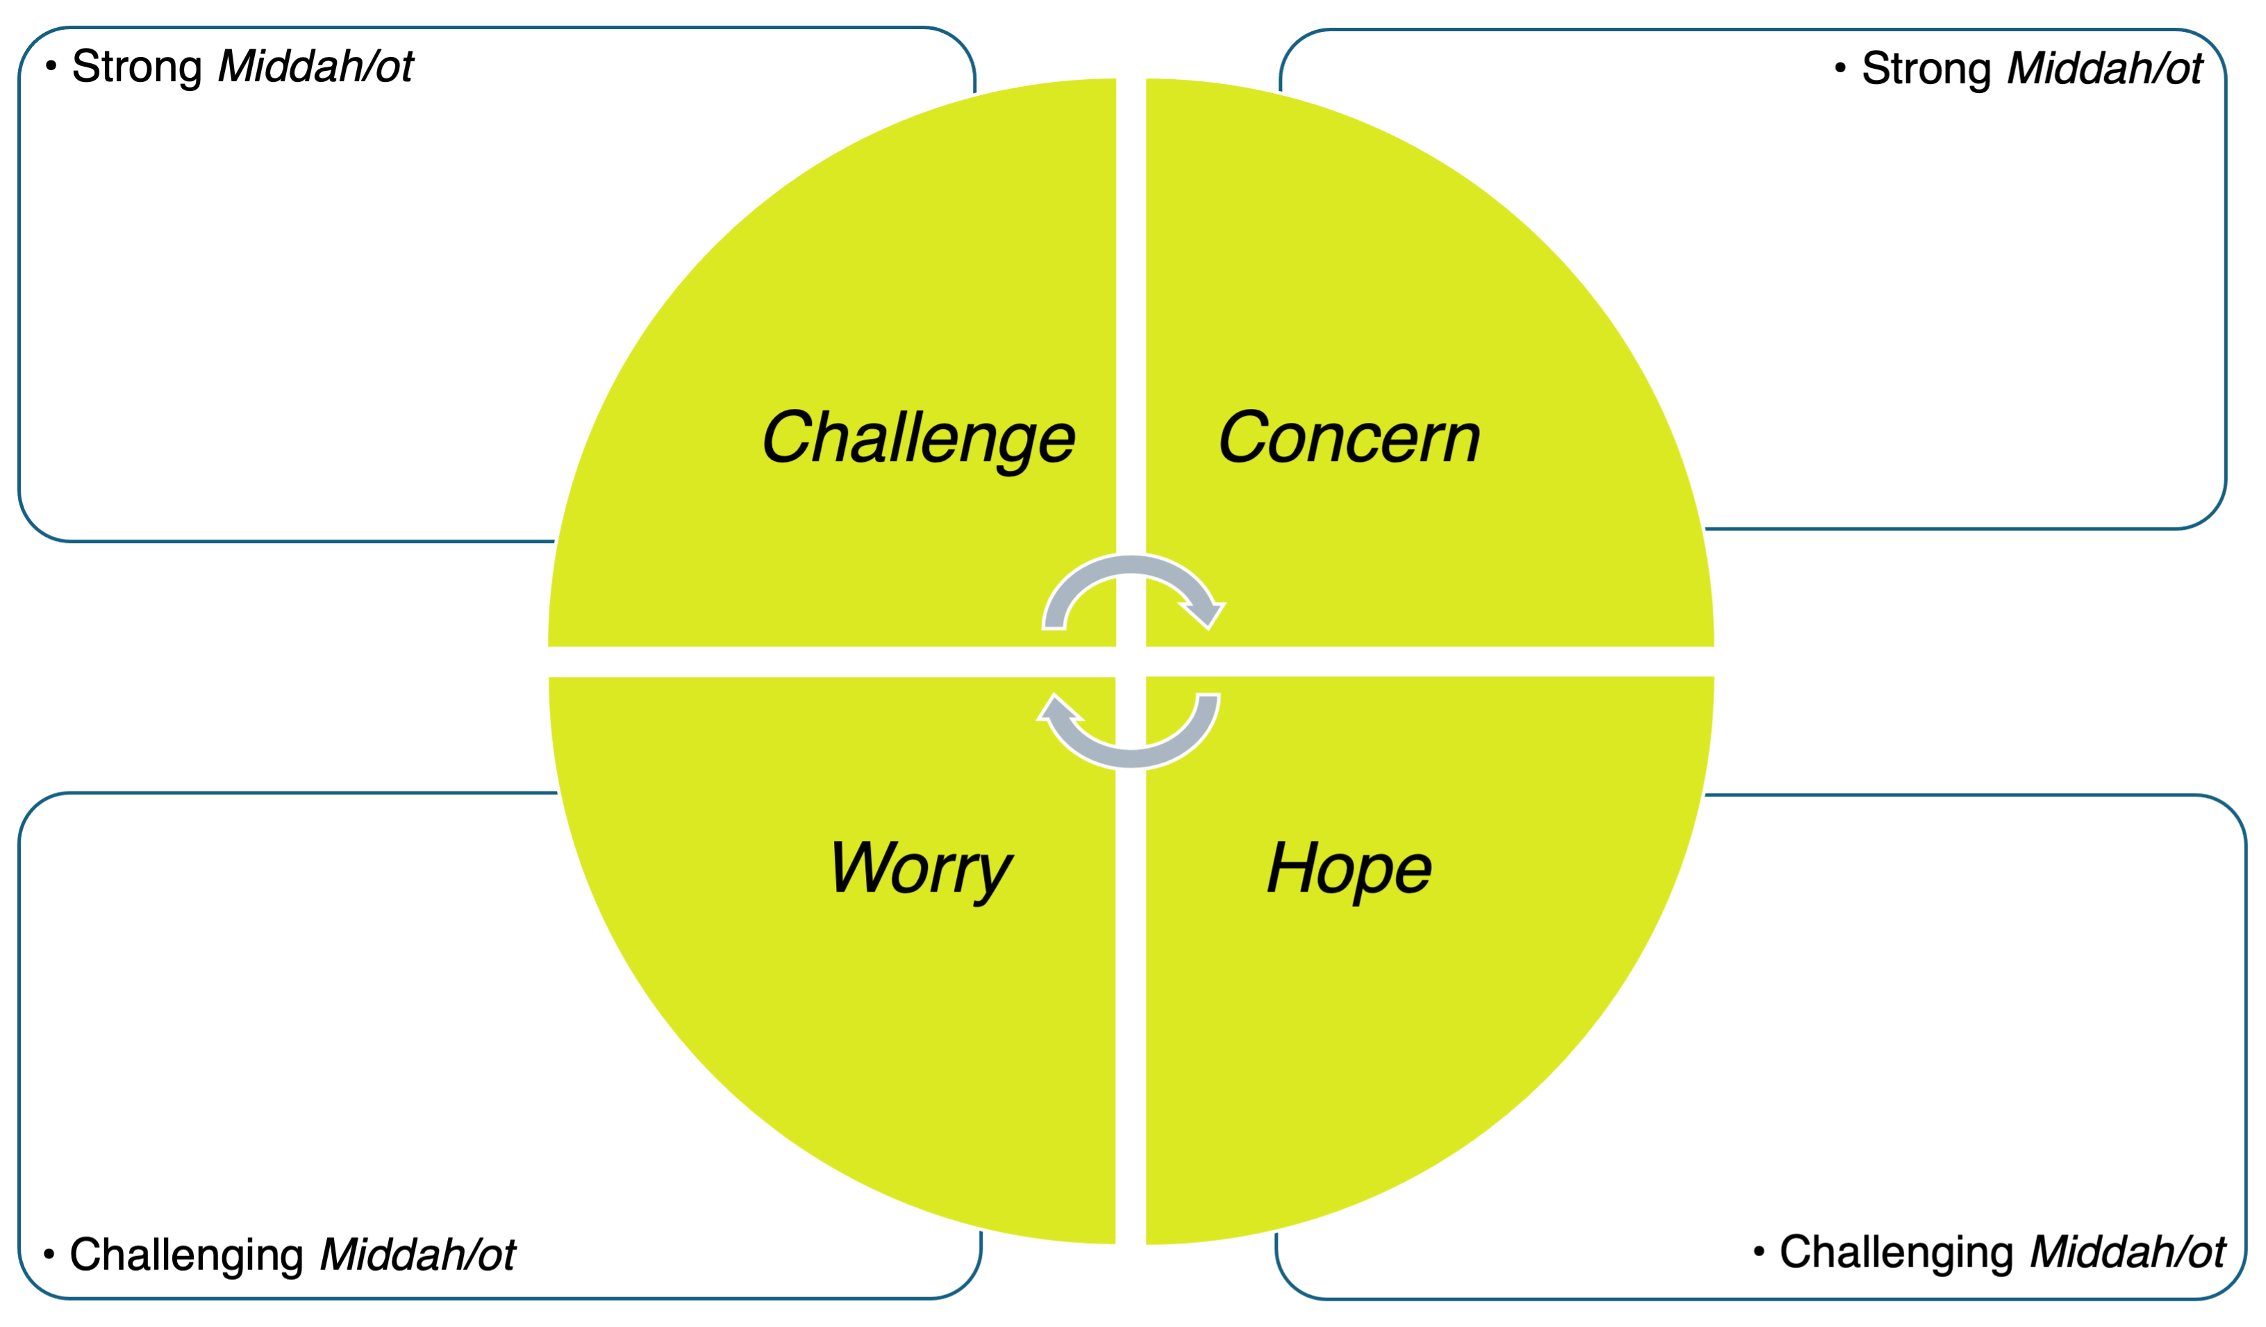
Using our Mussar Tools in a Time of Uncertainty by Eric Gurvis

